Slide 1


5 ½ Secrets to Resilience
Presented by Doug Hensch
Wednesday, December 14, 2016
Notes:
Turn controls over to Trudy.

Slide 2
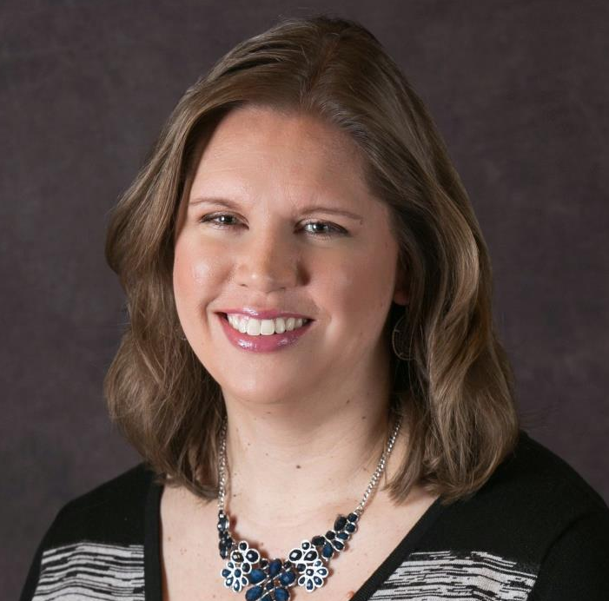
MODERATOR
Jen Linke
WISE Board of Directors
Chair of Professional
Development Committee
Jen has 20 years of retail and store brand experience. She is currently employed at Federated Group as Vice President of Category Management where she develops smart solutions to help grow sales for manufacturers, retailers and wholesalers.
Contact:
VP Category Management
Federated Group
jen.linke@fedgroup.com
http://www.linkedin.com/in/jenniferlinke

Slide 3
WOMEN IMPACTING STOREBRAND EXCELLENCE
WHO WE ARE
WHAT WE DO
CORE VALUES
Women Impacting Storebrand Excellence™, (WISE) is a non-profit professional development organization within store brands, created and led by women of the industry.
WISE fosters growth across the industry as a champion for diversity in leadership roles by offering educational opportunities, coordinating business networking events, and advocating informal mentorships for store brands professionals.
Leadership
Professional Development
Diversity
Collaboration
Integrity
For more information http://womeninstorebrands.com

Slide 4

AGENDA
Our Webinar Agenda
Welcome
Housekeeping
Introductions
Presentation of 5 ½ Secrets to Resilience
Upcoming WISE events & news

Slide 5
HOUSEKEEPING
Are you broadcasting this webinar?
Take a picture & tweet it or send it to
Jen.linke@fedgroup.com
  Send a note with a count of how
  many people are in the room.
  Submit questions throughout
the event!

Slide 6
Is this your first wise webinar?
POLL QUESTION

Slide 7
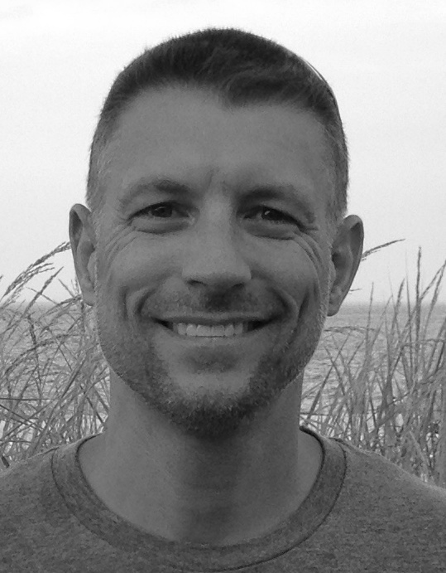
5 ½ Secrets to Resilience
Presented by Doug Hensch
Wednesday, December 14, 2016
Notes:
Turn controls over to Trudy.

Slide 8
5 ½ Secrets to Resilience
…and other tips to energize your work and personal life
Doug Hensch
The DRH Group
Doug@DRH-Group.com
www.DRH-Group.com

Slide 9
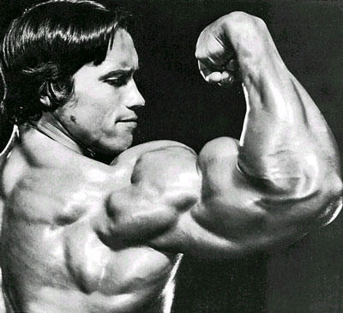
www.DRH-Group.com

Slide 10
Flexibility
10
www.DRH-Group.com
Notes:
dh

Slide 11
11
A brain teaser…
irusat
soyilnar
phipaer
godapo
dushra
sareka
heccrob
tiimmpso
hadniyg
focofe
Notes:
dh

Slide 12
What did you say to yourself?
How did you feel while the anagrams came and went?
tiimmpso
phipaer
optimism
happier
2/3 of Penn students unable to complete a simple crossword puzzle after trying this exercise
www.DRH-Group.com
Notes:
dh

Slide 13
What can you do?
Pause.
Consider.
Choose.
www.DRH-Group.com

Slide 14
Optimism
14
www.DRH-Group.com
Notes:
dh

Slide 15
How can we spot an optimistic or a pessimist thinker?
www.DRH-Group.com
Notes:
Create two flip charts: “Optimists tend to say…” and “Pessimists tend to say…”
Flip chart answers from each table
Explain that we will come back to their answers in a little while…move on to Explanatory Style

Slide 16
Optimistic Thinkers vs. Pessimistic Thinkers
Three crucial dimensions to Explanatory Style
Permanence vs. Temporary (Time)
  It’s never going to change
Pervasiveness vs. Specific (Scope)
  It’s in every part of my life
Personalization vs. External (Me or Not Me)
  It’s all my fault
www.DRH-Group.com

Slide 17
What can you do?
Be mindful of your language – is it accurate?
www.DRH-Group.com

Slide 18
Curiosity
18
www.DRH-Group.com
Notes:
dh

Slide 19
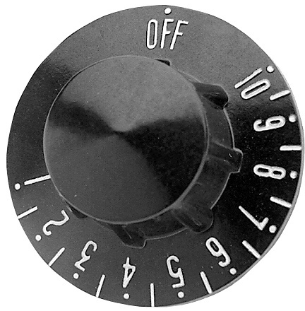
High
Low
Anxiety
Curiosity
Curious people: test & explore
Anxious people: good vs bad
www.DRH-Group.com
Notes:
Discuss how the “knob” for anxiety is not connected to anything…we do, however, have control of our attention and we can dial up our curiosity.
Say, “When we do this, our anxiety may go up or down but at least it can move.”
Reveal the quote and talk about how simply understanding that you have control of your attention can help activate your curiosity which can lower anxiety

Slide 20


Slide 21
What can you do?
Wear a mindfulness bracelet/band.
www.DRH-Group.com

Slide 22
Uplifting
(aka Positive Emotions)
www.DRH-Group.com

Slide 23
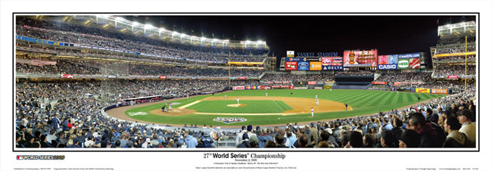
www.DRH-Group.com
Notes:
1 – negativity narrows our focus and limits our psychological responses to adversity; positivity broadens our view and allows us to see more options
2 – positivity has been shown to predict greater longevity by up to 10 years
3 – positivity creates an upward spiral; one meta analysis resulted in showing that positivity can predict success AND be a result

Slide 24

www.DRH-Group.com
Notes:
1- talk about fredrickson’s ‘open heart study’
2 – discuss online gratitude intervention (seligman) – with oprah picture
3 – talk about why negative emotions can actually have a positive

Slide 25
What can you do?
You tell me…
www.DRH-Group.com

Slide 26
Support
26
www.DRH-Group.com
Notes:
dh

Slide 27
Being socially engaged is associated with…
  …a lower risk of coronary disease.
  …catching fewer colds.
  …getting less infections.
  …living a longer life.
Source: Davidson & Begley, The Emotional Life of Your Brain
www.DRH-Group.com

Slide 28

High-Quality Connections
Respectful engagement
Task enabling
Play!
Source: Stephens, J.P., Heaphy, E. & Dutton, J. High Quality Connections
www.DRH-Group.com
28

Slide 29

What can you do?
Express appreciation…outwardly
www.DRH-Group.com

Slide 30
½ Secret…
30
www.DRH-Group.com
Notes:
dh

Slide 31

31
www.DRH-Group.com
Notes:
dh

Slide 32
Which skill is most useful to you, right now?
Flexibility
Optimism (realistic)
Curiosity
Uplifting (aka positive emotions)
Support
and…Quitting
www.DRH-Group.com

Slide 33
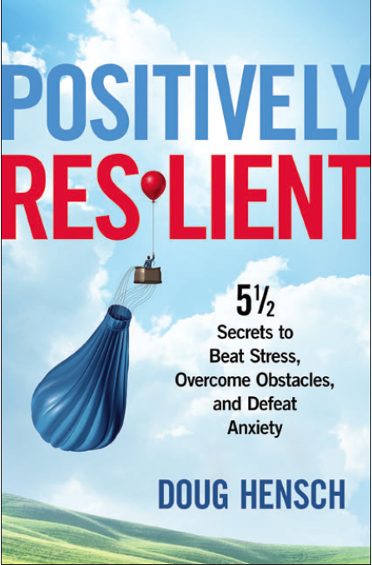
“In the middle of difficulty lies opportunity.”
-Albert Einstein
Thank you!
Doug@DRH-Group.com
bit.ly/DRHgroup
www.DRH-Group.com

Slide 34

QUESTIONS AND ANSWERS

Slide 35

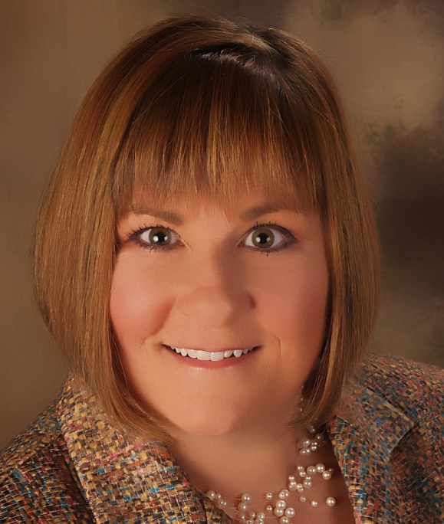

“The Five Types of Employees: How Agile Leadership Styles Can Optimize Results”
Dr. Sherene McHenry
SAVE THE DATE!
Thursday, January 26, 2017
12:00 - 1:00 pm CST
Registration is Complimentary
www.womeninstorebrands.com/events

Slide 36
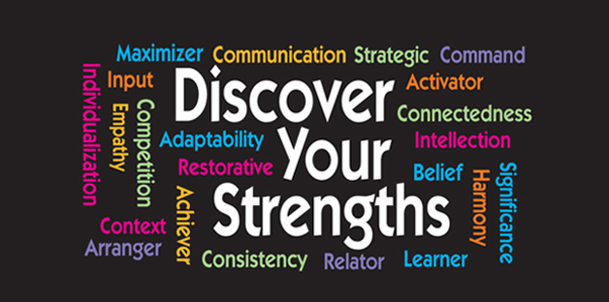
NEW in 2017!
Discover how to Leverage your Strengths for Career Success
Exclusive Webinar Series for Partner Companies & Members
4 Session Series Starting in February 2017
Notes:
StrengthsFinders raises your self-awareness, raises your team awareness and engagement & can help your work be more meaningful. This is a tremendous value to be trained in StrengthsFinders and it’s a complimentary offering to members & partner companies. Take advantage of it.

Slide 37


Presents
Online Professional Development Tools & Mentoring
Career & Leadership Development Planning Tools
Resource Training Library has 30+ Core Practice Lessons on Professional/Leadership Development
Monthly Group Discussion & Networking for shared learnings
Self-Managed Mentoring Program to assist in developing a successful in-house mentoring program
Close the Experience Gap with WISE and InPower Coaching!

Slide 38























Thank You to Our Partners
Premier Partners
Diamond Partners
Platinum Partners
Gold Partners

Slide 39






























Thank You to Our Partners
Silver Partners
Bronze Partners
Industry Partners
WISE WOMEN IMPACTING STOREBRAND EXCELLENCE

Slide 40
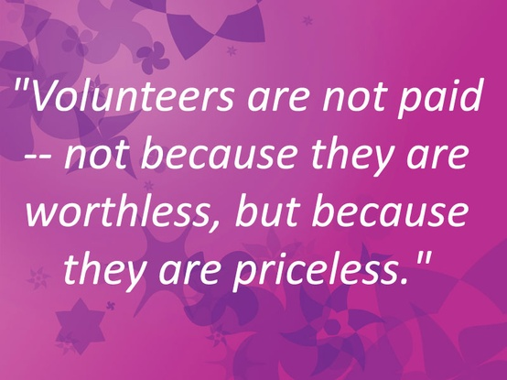
VOLUNTEER
Want to do more with WISE?
Enhance your professional skills
Become an “insider”
Be challenged
Be an agent of “change”
Network with industry leaders
Getting involved is easy! Be WISE! Contact Peggy Davies
peggyd@womeninstorebrands.com

Slide 41

NOW AVAILABLE!
Gain access to Articles | Websites | Books | Videos
To increase knowledge & understanding of industry topics.

Slide 42




Connect with
www.womeninstorebrands.com

Slide 43
How can we improve our webinars?
Suggestions for speakers?
Please respond to our brief evaluation of this webinar.
Thank you to Doug Hensch
and to you for attending
today’s webinar.
For additional information about WISE please
visit womeninstorebrands.com

